Slide 1
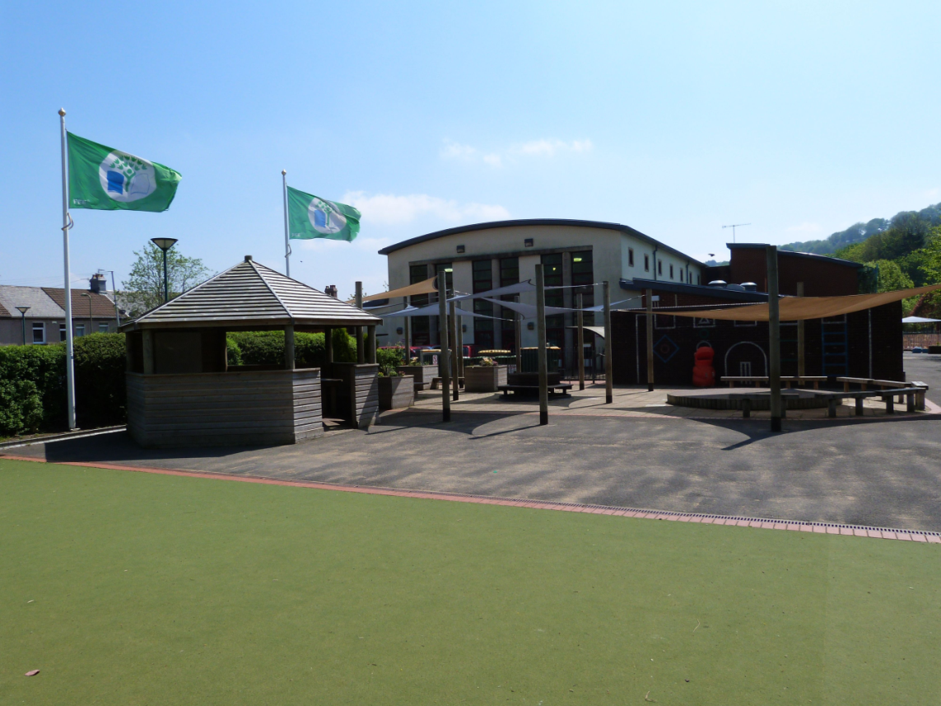
RISCA Primary School

Slide 2
RISCA Primary School
The New Curriculum

Slide 3
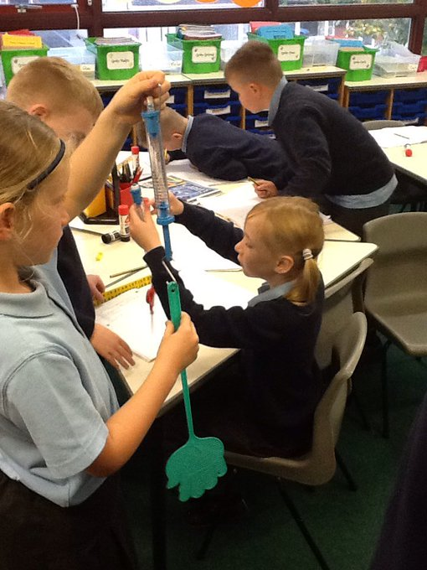
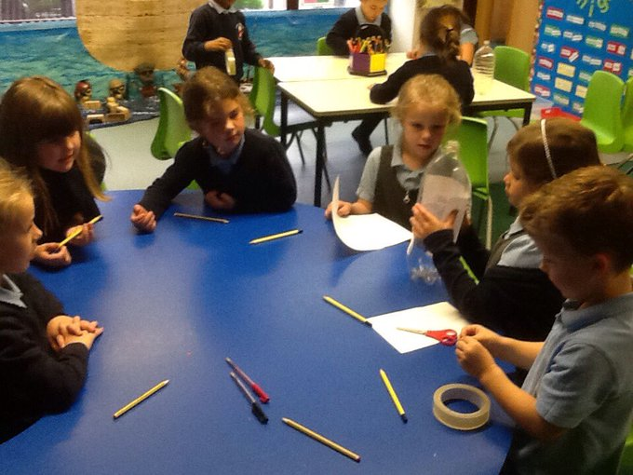
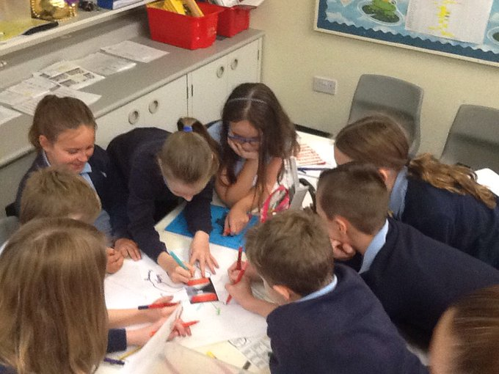
The whole approach to developing young people aged 3 to 16 is changing.

Slide 4
The new curriculum will have more emphasis on equipping young people for life.
It will build their ability to learn new skills and apply their subject knowledge more positively and creatively.
As the world changes, they will be more able to adapt positively.

Slide 5
Children will also get a deep understanding of how to thrive in an increasingly digital world.
A Digital Competence Framework is now introducing digital skills across the curriculum, preparing them for the opportunities and risks that an online world presents.

Slide 6
But
why do things need to change?

Slide 8
A global report in 2017, authored by the Institute for the Future (IFTF), estimated that:
‘85% of the jobs that will exist in 2030 haven't even been invented yet’.

Slide 9
A renowned American psychologist, John Dewey said:
‘You cannot teach today the same way you did yesterday to prepare students for tomorrow’.

Slide 10
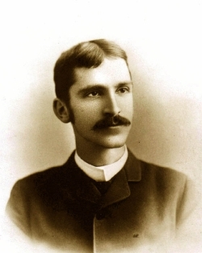
Born
October 20, 1859
Died
June 01, 1952

Slide 11
With the new curriculum, teachers and schools will have more freedom to teach in ways they feel will have the best outcomes for their learners.

Slide 12
The Core Four Purposes of the new curriculum is to support our children and young people to be:
ambitious, capable learners, ready to learn throughout their lives
enterprising, creative contributors, ready to play a full part in life and work
ethical, informed citizens of Wales and the world
healthy, confident individuals, ready to lead fulfilling lives as valued members of society.

Slide 13
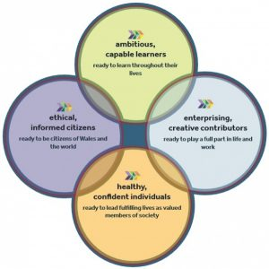
The Four Purposes that underpin the new Welsh Curriculum

Slide 14
Risca Primary Interpretation of the Four Purposes
Always trying to do our best

Slide 15
Risca Primary Interpretation of the Four Purposes
Sharing ideas and solving problems

Slide 16
Risca Primary Interpretation of the Four Purposes
Looking after Wales and the World

Slide 17
Risca Primary Interpretation of the Four Purposes
Looking after our bodies and minds

Slide 18
The new curriculum will have six ‘Areas of Learning and Experience (AoLEs).
Expressive arts.
Health and well-being.
Humanities (including RE which should remain compulsory to age 16).
Languages, literacy and communication (including Welsh, which should remain compulsory to age 16, and modern foreign languages).
Mathematics and numeracy.
Science and technology.

Slide 20
April 2019: New curriculum and assessment arrangements available in schools for feedback.
January 2020: Final curriculum and assessment arrangements available.
September 2022: All maintained schools and settings using the new curriculum and assessment arrangements.
The first teaching of all year groups from primary school to Year 7 will begin in September 2022 and the new curriculum will roll out year-on-year from this point.

Slide 21
The new curriculum is being developed by teachers and practitioners through a network of Pioneer Schools.

Slide 22
These schools have been drawn from across Wales, including settings that are rural and urban; bilingual, English-medium and Welsh-medium; primary, secondary, special schools, schools with a religious character and a range of school sizes.

Slide 23
The Pioneer Schools Network is working as part of an all-Wales partnership with:
local authorities
regional consortia
the schools inspection body Estyn
external experts
the further and higher education sectors
employers
Welsh Government
other key stakeholders.

Slide 24
Risca Primary School is a Professional Learning School for Health and Wellbeing

Slide 25
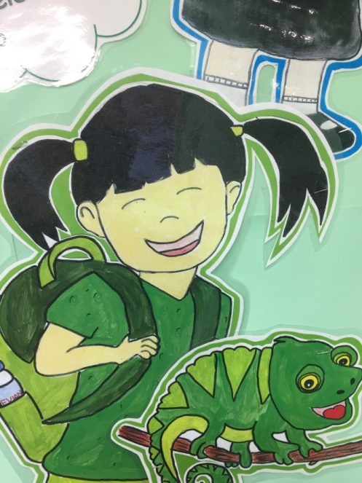
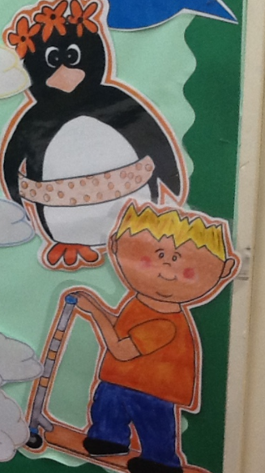
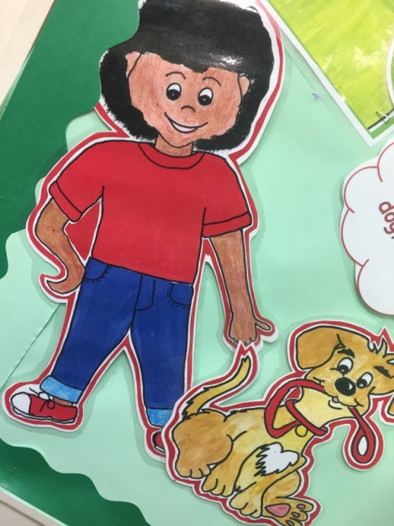
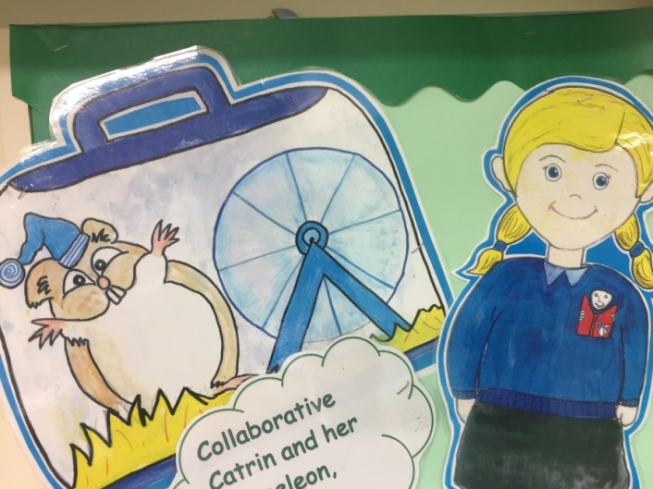
We have introduced our own growth mindset characters. (Take a look on our website)

Slide 26
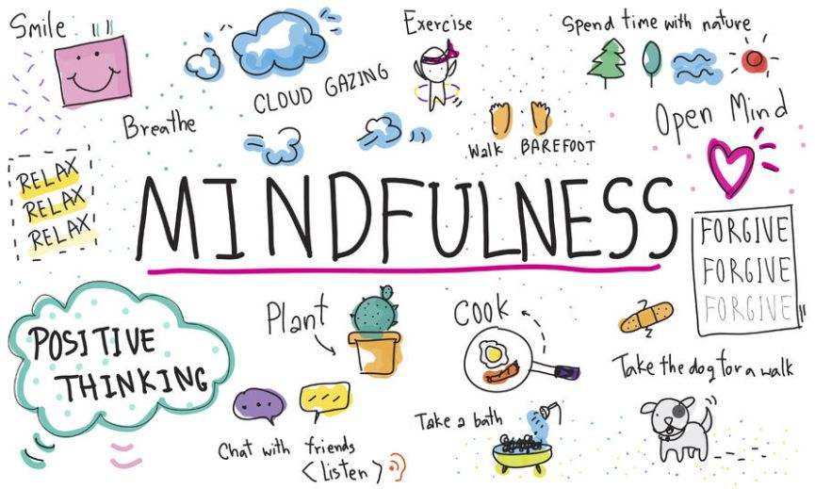
Year 5/6 have completed a mindfulness course

Slide 27
Year 3/4 use RelaxKids

Slide 28
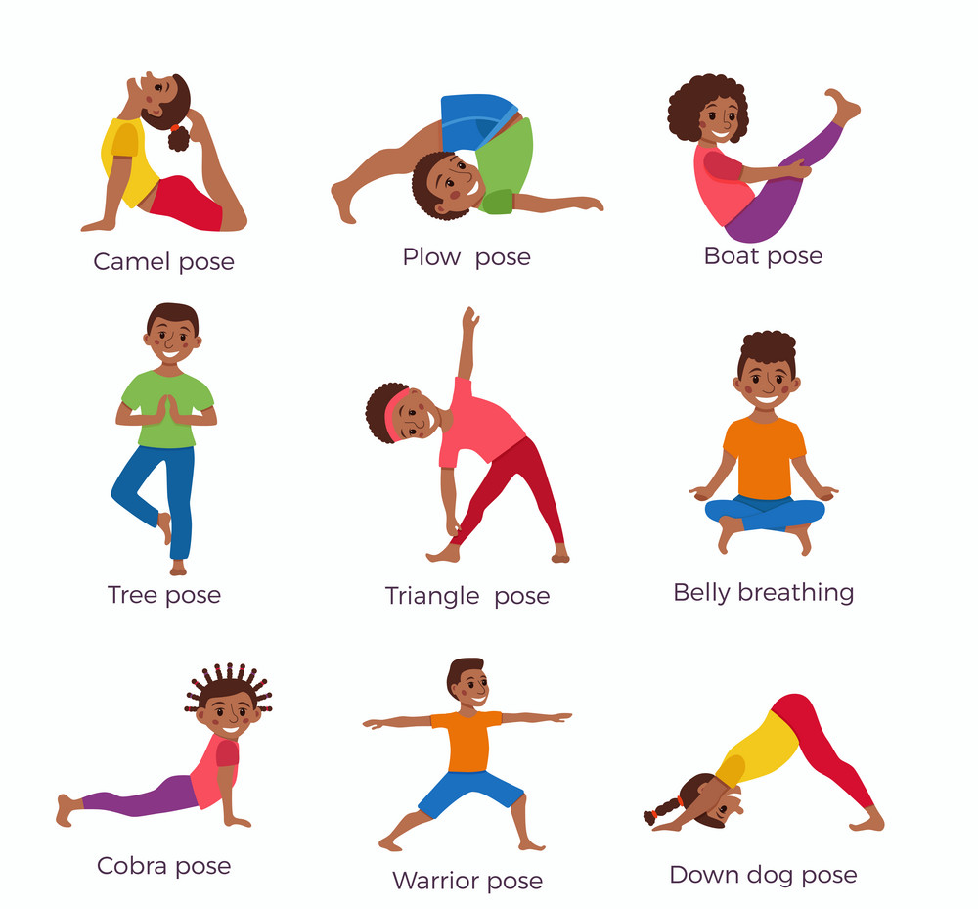
Foundation Phase will do yoga later in the year

Slide 29
Look at our website:
https://www.riscaprimary.co.uk/
Join our TWITTER feed: @Riscaprimary

